Slide 1
Image Generation using GAN
SUBMITTED BY
SIDHARTH BABU.B
NM ID: au711721243101
KGiSL INSTITUTE OF TECHNOLOGY
3/21/2024 Annual Review

Slide 2
Image Generation using GAN
3/21/2024 Annual Review

Slide 3


AGENDA
PROBLEM STATEMENT
PROJECT OVERVIEW
END USERS
SOLUTION AND PROPOSITION
KEY FEATURES
MODELLING APPROACH
RESULT
3/21/2024 Annual Review

Slide 4

PROBLEM STATEMENT
The challenge lies in developing a generative adversarial network (GAN) architecture that can generate realistic 32x32 color synthetic images, mimicking the CIFAR-10 dataset closely. Widely used in computer vision research, CIFAR-10 is a benchmark dataset consisting of 60,000 images across 10 classes. The goal is to create high-quality, diverse, and visually convincing 32x32 color images that are indistinguishable from the real CIFAR-10 images.
3/21/2024 Annual Review

Slide 5

PROJECT OVERVIEW
The project aims to implement a Generative Adversarial Network (GAN) architecture using Keras and TensorFlow to generate synthetic images resembling real images from the CIFAR-10 dataset. CIFAR-10 is a widely-used benchmark dataset in computer vision, containing 60,000 32x32 color images across 10 classes.
3/21/2024 Annual Review

Slide 6

WHO ARE THE END USERS?
Researchers in Computer Vision: Researchers working in the field of computer vision, deep learning, and generative modeling can utilize the developed GAN model as a tool for exploring new techniques, advancing the state-of-the-art in image synthesis, and conducting experiments in image generation tasks.
Industry Practitioners: Companies and organizations working on computer vision applications, such as autonomous vehicles, robotics, surveillance systems, or image analysis tools, would have a strong interest in leveraging a generative model.
3/21/2024 Annual Review

Slide 7

YOUR SOLUTION AND ITS VALUE PROPOSITION
Solution: Our GAN model generates realistic images akin to CIFAR-10 dataset.
Value:
Realistic Image Generation: Creates lifelike synthetic images.
Data Augmentation: Boosts model robustness with varied synthetic data.
Creative Content: Enables artistic image production and exploration.
Cost Efficiency: Eliminates pricey real-data collection.
Product Design: Aids rapid prototyping and visualization.
Education: Supports learning and experimentation.
Innovation: Encourages AI exploration and discovery.
3/21/2024 Annual Review

Slide 8
THE WOW IN YOUR SOLUTION
Hyper-realistic Images: Our GAN generates images that blur the line between synthetic and real.
Boundless Creativity: Empowers users to unleash artistic expression and visionary concepts effortlessly.
Instant Data Amplification: Expands dataset diversity instantly, enhancing model robustness and insights.
Resource Efficiency: Saves time and costs by eliminating exhaustive data collection processes.
Revolutionizes Design: Transforms prototyping and visualization, elevating product innovation to new heights.
Educational Powerhouse: Sparks curiosity and fosters experimentation in AI and generative modeling.
Innovation Catalyst: Inspires bold exploration and propels groundbreaking discoveries in AI.
3/21/2024 Annual Review

Slide 9
MODELLING
Data Preprocessing:
1. Normalize Pixel Values: Rescale pixel values to a range between 0 and 1 for numerical stability.
Data Splitting: Organize the CIFAR-10 dataset into training and validation sets to assess model performance.
Generator Design:
2. Deep Neural Network: Develop a deep neural network architecture to generate synthetic images from random noise vectors (latent space).
Convolutional Layers: Utilize convolutional layers to learn hierarchical representations of features in the input noise vectors.
Transpose Convolutional Layers: Employ transpose convolutional layers to upsample the noise representations and generate image-like outputs.
Activation Functions: Apply activation functions such as LeakyReLU to introduce non-linearity and enable the model to learn complex patterns.
Output Layer: Use the Tanh activation function in the output layer to scale the pixel values to the range [-1, 1] to match the input data distribution.
3/21/2024 Annual Review

Slide 10
3. Discriminator Design:
Binary Classifier: Design a binary classifier that distinguishes between real CIFAR-10 images and synthetic images generated by the generator.
Convolutional Layers: Utilize convolutional layers to extract features from the input images and learn discriminative representations.
Activation Functions: Apply LeakyReLU activation functions to introduce non-linearity and enable the discriminator to learn complex decision boundaries.
Output Layer: Use a single sigmoid activation neuron in the output layer to predict the probability that the input image is real (1) or fake (0).
4. Training Strategy:
Adversarial Training: Implement a minimax game between the generator and discriminator, where the generator aims to generate realistic images to fool the discriminator, while the discriminator learns to distinguish between real and fake images.
Loss Functions: Use binary cross-entropy loss for both the generator and discriminator to quantify the difference between predicted and target labels.
Optimization: Apply the Adam optimizer with appropriate learning rates to update the weights of the generator and discriminator networks during training.
Mini-Batch Training: Train the model in mini-batches to efficiently utilize computational resources and improve convergence speed.
Hyperparameter Tuning: Experiment with different hyperparameters such as learning rates, batch sizes, and network architectures to optimize model performance.
5. Evaluation Metrics:
Inception Score: Compute the Inception Score to measure the quality and diversity of the generated images based on the predictions of an Inception-v3 model.
Frechet Inception Distance (FID): Calculate the FID to assess the similarity between the feature distributions of real and generated images using feature embeddings from the Inception-v3 model.
Visual Inspection: Conduct visual inspection of the generated images to evaluate their visual quality, realism, and diversity qualitatively.
6. Deployment:
Save and Load Models: Save the trained generator and discriminator models to disk for future use and deployment.
Documentation: Provide comprehensive documentation and usage guidelines to facilitate the deployment of the trained GAN model in various applications.
Integration: Integrate the GAN model into production systems or applications through APIs or libraries for seamless integration and usage by end-users.

Slide 11
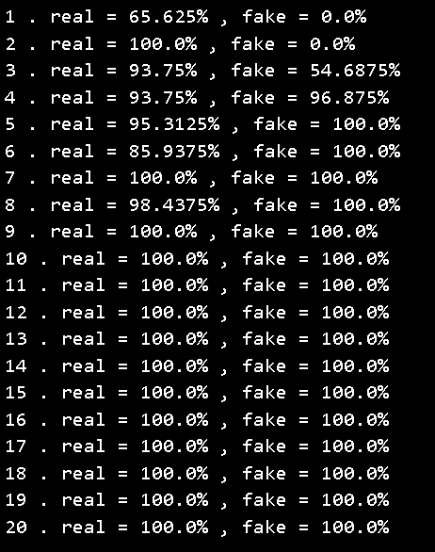
RESULTS
High Fidelity: Images closely resemble real CIFAR-10 images.
Diverse Outputs: Model produces varied outputs across classes.
Quality Metrics: Metrics confirm high image quality and realism.
Stable Training: Training process shows stability and consistent improvement.
Successful Applications: Users report successful data augmentation and creative endeavors.
Educational Impact: Model aids learning and experimentation.
Innovation Potential: Results inspire further AI innovation and exploration.
3/21/2024 Annual Review

